Slide 1

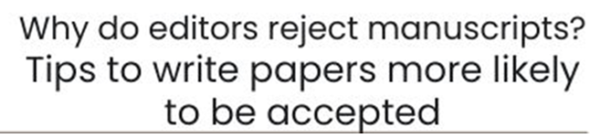



Introduction:
why editors [of good scientific journals] reject [a lot of] papers?
Gustavo A. Slafer

Slide 2
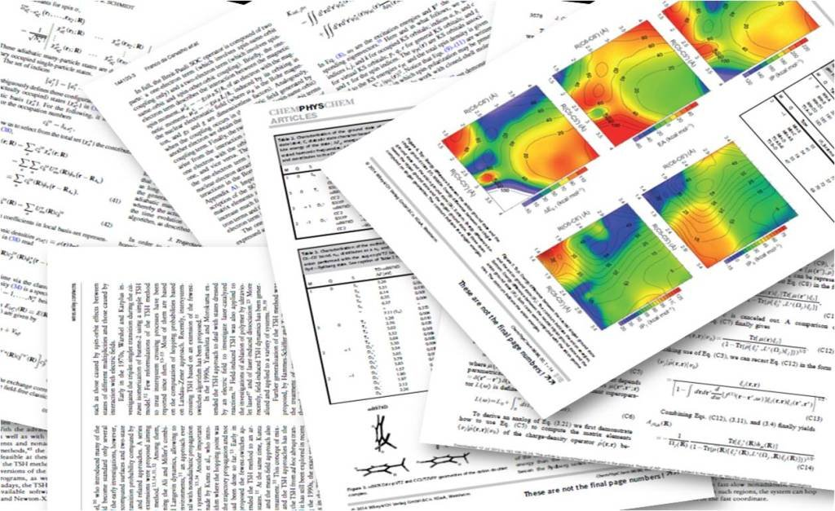

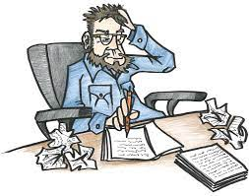
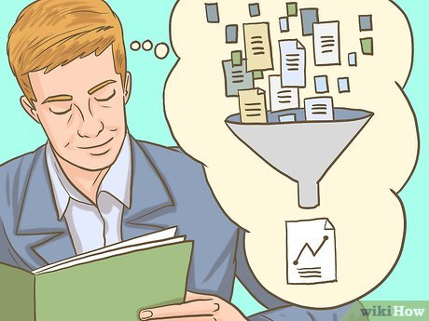
Editor and Reviewers
Huge discrimination
Papers in scientific journals
Author Reader
Papers are published for the readers NOT for the authors
Gustavo A. Slafer

Slide 3
How much must a Reader read?
Ideal world: EVERYTHING
How much is everything?
1.8 million articles published each year
2012 STM Report
(International Association of Scientific, Technical and Medical Publishers)
Annual research article output (3% annual growth)
Doubling time for annual output for articles of just under 24 years
Jinha, 2010. Learned Publishing, 23:258–263
Gustavo A. Slafer

Slide 4
# of papers published in scientific journals per year
[c. 2,000,000 papers y⁻¹]
What about you?
(and each of the readers of scientific papers in the world)
# of papers published in “my topic” [c. 5K y⁻¹]
# of papers published in “my field” [c. 100K y⁻¹]
# of papers I read (and not always in full) [c. 100 y⁻¹]
Gustavo A. Slafer

Slide 5
Journals are published for readers
Readers cannot read more than a tiny fraction of what they think they should read!
There is no sense in publishing more papers, and
There is a lot of sense in publishing “better” papers (so that readers are not disappointed very often and have a good objective criterion for discriminating what to read and what to ignore)
Gustavo A. Slafer

Slide 6
Good journals reject 75-85% of mss submitted
  And ONLY receive papers that authors consider “good enough”
  Most papers rejected may not be “bad”, simply “not good enough”
  Most papers rejected in “top journals” in our field would be acceptable in Q3 or Q4 journals (they are not flawed, they simply are not “novel enough” and/or not “relevant enough” for the “top-ranked” journals in the field).
  But we write for readers, and they discriminate heavily against les respected journals
  If we want our papers to be published in the journals most respected in our field, doing great research may not be enough: we need the editors (and reviewers) to consider our submission within the best…
Gustavo A. Slafer

Slide 7
Why papers are rejected?
A. Through “technical screening” (before passing to the Editor)
  Plagiarism (including self-plagiarism!)
  Paper under review at another journal
  Missing parts
  Quality of the language is not sufficient for review
B. “Desk-rejection” by the Editor (before peer-review)
All “A” plus
  Scope (true scope, regardless of the “declared scope”)
  Over-ambitious research (results difficult to interpret or may even be flawed = divide into understandable units avoiding MUPs)
  Poor/Inexistent hypothesis (unclear, or poorly formulated, or not relevant research question)
  Major flaws in the procedures, presentation, analysis of the data, or arguments
  Lack of adherence to journal guidelines to authors
Gustavo A. Slafer

Slide 8
Why papers are rejected?
C. After peer review
All “A+B” plus
  Inadequate problem statement
  Inappropriate/outdated literature used (or biased to self-citation without justification)
  Not clear the relevance
  Not clear the novelty
  Inadequate research design
  Sampling problems (size, timing, details)
  Poor data collection (instruments, timing)
  Inadequate analyses (including statistical analyses)
  Unclear presentation of Results
  Inconsistency Results-Aims
  Inappropriate discussion (internal coherence), not just adding refs, proper interpretation // reasonable and justified speculation [while avoiding “overinterpretation”]
  Conclusions NOT supported by Results
Gustavo A. Slafer

Slide 9
Options for rejected submissions
Appeal the decision (depending on the result, submit a revised version)
  decision was unfair (intentional[??] // major flaws in the review process)
  decision was fair but you think the major problems identified can be solved
Submit your REVISED manuscript to a different journal
Discard the manuscript and never resubmit it
  You understand the problem and recognise it is better NOT to publish that work (to avoid working more to publish the ms in an obscure journal (and if the ms is seen by a colleague you would not feel proud)
Gustavo A. Slafer

Slide 10
Quality of research is essential…. But it may not be enough.
Quality in writing to highlight the scientific quality is critical, for acceptance and even more for impact with the potential readers (many papers in best journals are ignored)
Robert will trigger some ideas for later discussion on this
Gustavo A. Slafer

